Slide 1
Blade Template in Laravel

Slide 2
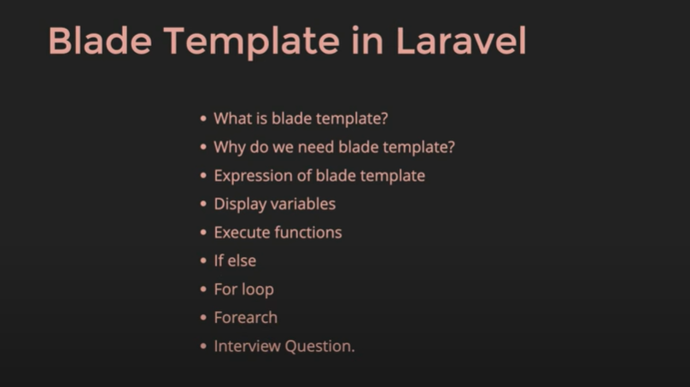
Blade Template in Laravel

Slide 3
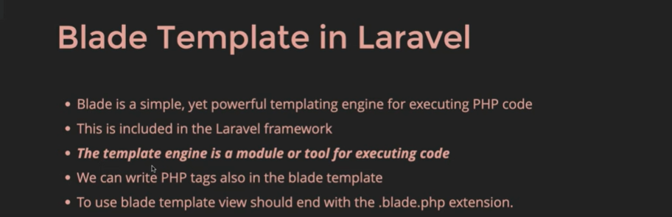
Blade Template
It is faster than normal php code execution
Expressions are simple

Slide 4
{{ }}
{{ }} is called experession

Slide 5
<?php namespace App\Http\Controllers; use Illuminate\Http\Request; class MyController extends Controller
{
function getview(){ //create the function name
$name="Amit";
return view('new',["user"=>$name]); //return the view with this function
}

Slide 6
Call the function getview
use App\Http\Controllers\MyController;
Route::get('/getview',[MyController::class,'getview']);

Slide 7
{{}} is simple
<h1> This is New Page </h1>
{{$user}}
<h1>
<?php
echo $user;
?>
</h1>

Slide 8
We can use PHP inbuilt function in blade template
<?php
$str= "Amarinder";
$len= strlen($str);
echo "The length of the string is $len";
$word=str_word_count($str);
echo "The word length is $word";
?>

Slide 9
Try to pass an array through view and passing the 2 variables also
<?php namespace App\Http\Controllers;
use Illuminate\Http\Request;
class MyController extends Controller
{
function getview(){ //create the function name
$name="Amit";
$users=["aman","rohit","sherry"];
return view('new',["user"=>$name,"users"=>$users]); //return the view with this function
}

Slide 10
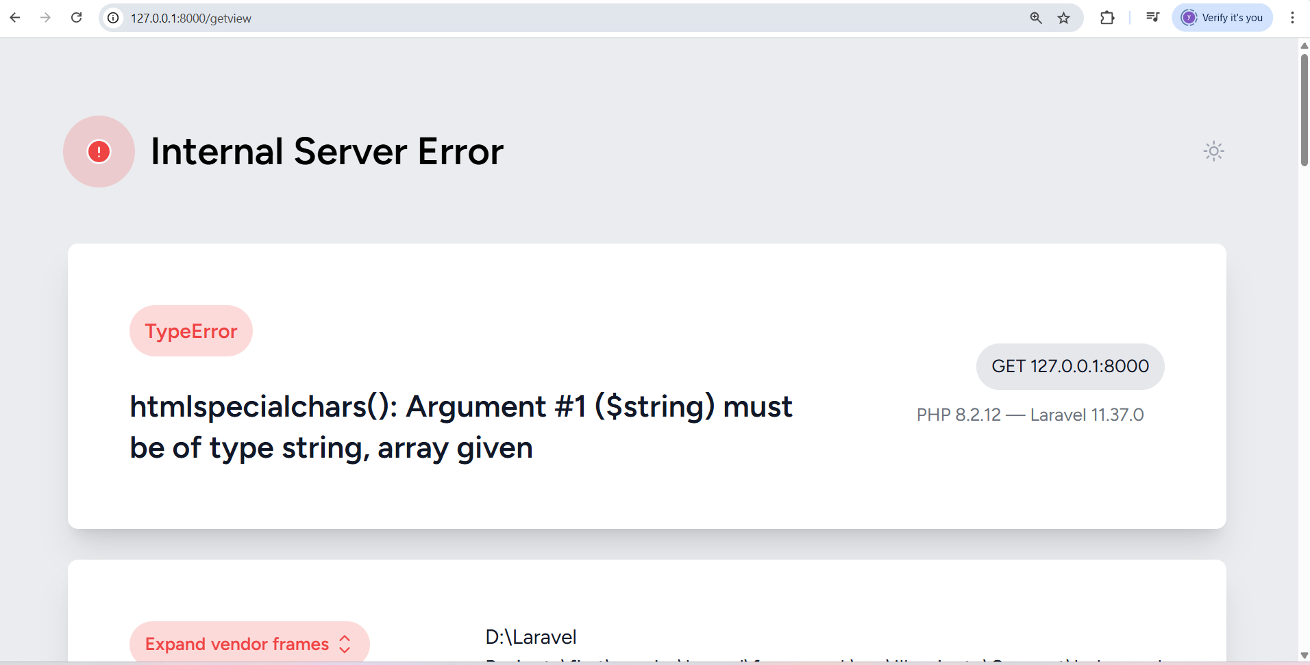
If we write {{$users}} it will give an error

Slide 11
{{$users[0]}}
If we add {{$users[0]}} in the blade template then it will work

Slide 12
Means we can run foreach() loop also
@foreach ($users as $user)
{{$user}}
<br>
@endforeach

Slide 13
Check even or odd in blade template
@if(45 % 2 == 0)
<h4> The num is even </h4>
@else
<h4> The num is odd </h4>
@endif

Slide 14
For loop in blade template
<div>
@for ($i=0;$i<=10;$i++)
{{$i}}
<br>
@endfor
</div>

Slide 15
Table in Blade Template
<div>
@for ($i=0;$i<=10;$i++)
2 * {{ $i }} = {{2 * $i}}
<br>
@endfor
</div>

Slide 16
Laravel Basic Topics
Routing
View
Model
Controller
HTML, CSS and Blade Template

Slide 17
Blade Template
Templating engine for PHP
Small Code , Clean and easy
Dynamic and Reusable Template
create modular and reusable views quickly.

Slide 18
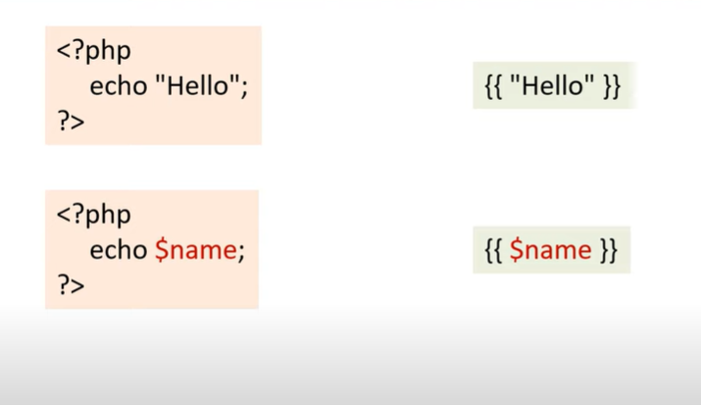
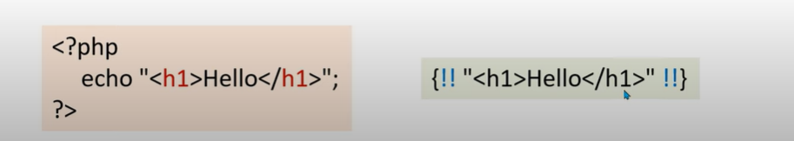
Basic Syntax

Slide 19
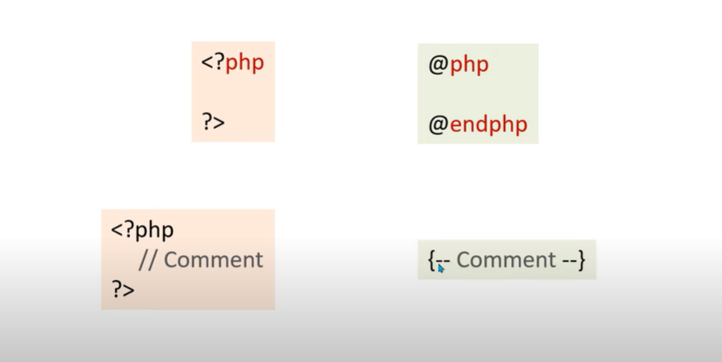
PHP and PHP Comments

Slide 20
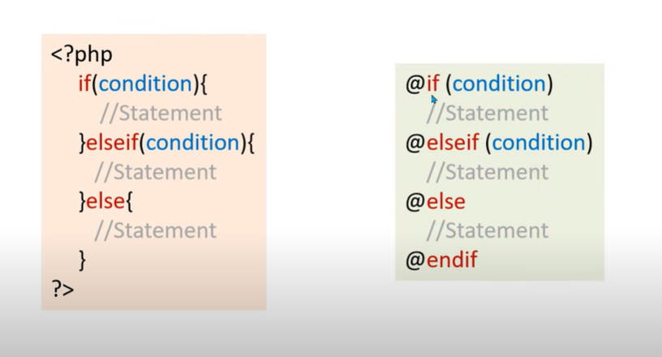
@if - @elseif -@else -@endif

Slide 21
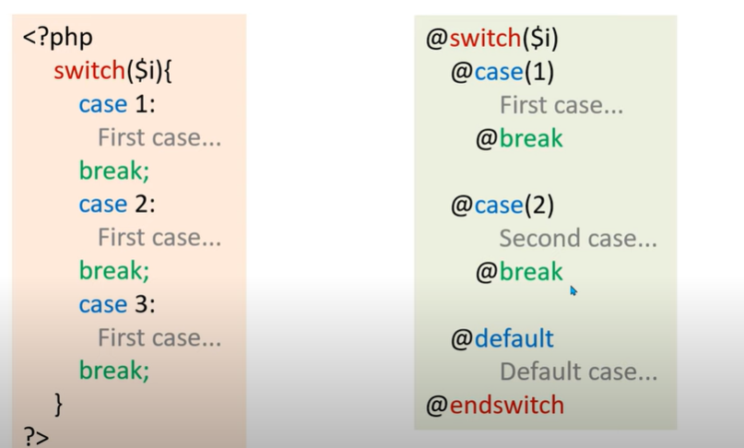
@switch

Slide 22
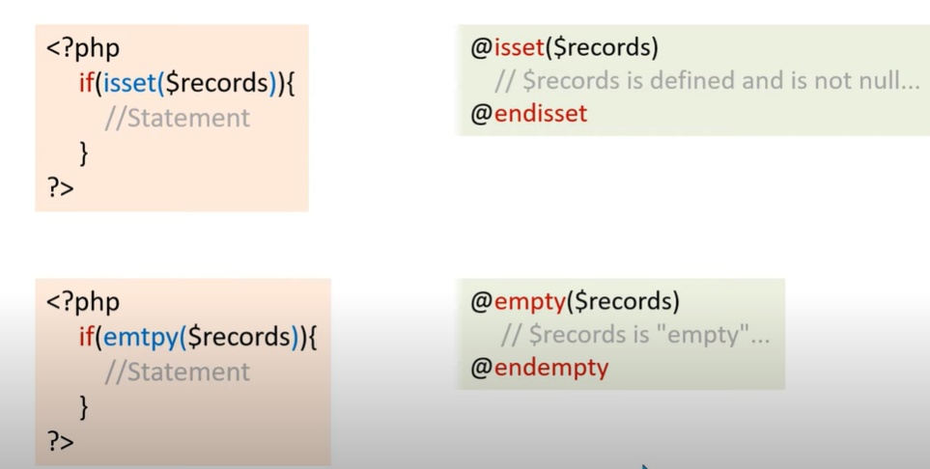
@isset and @isempty

Slide 23
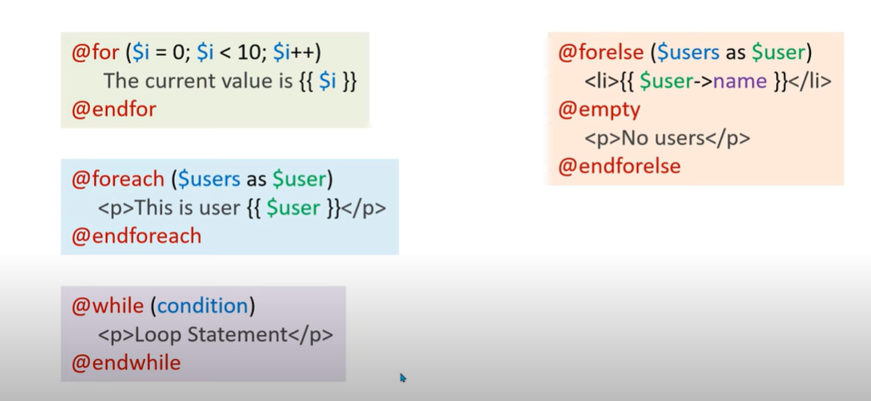
Blade Loop Statement Syntax

Slide 24
Continue and Break
@continue
@break

Slide 25
Example- to print a variable using blade
@php
$name="raj"; // static variable
@endphp
{{$name}}
{{--using route or controller for dynamic variable--}}

Slide 26
Adding HTML and JS in Blade Template
{!! " <h1> Hi </h1>" !!}
{!!"<script> alert("Hi") </script>" !!}

Slide 27
Comment Statement
{{-- Comment Statement --}}

Slide 28
Declaring and Using Variable
@php
$user="amit";
@endphp
{{$user}}

Slide 29
Arrays in Blade template
@php
$cars=["zen","alto","swift"];
@endphp
<ul>
@foreach ($cars as $car)
<li> {{$car}} </li>
@endforeach
</ul>

Slide 30
@- Print the Same
@{{$user}}

Slide 31
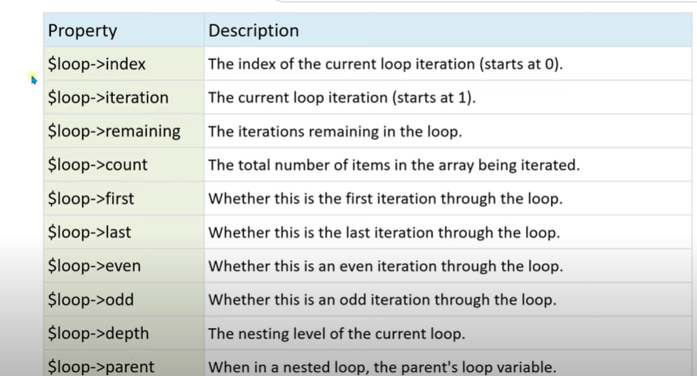
$loop is inbuilt variable and Index are properties

Slide 32
{{$loop->index}}-
@php
$cars=["zen","alto","swift"];
@endphp
<ul>
@foreach ($cars as $car)
<li> {{$car}} </li>
@endforeach
</ul>
@{{$user}}

Slide 33
{{$loop->iteration}}
@php
$cars=["zen","alto","swift"];
@endphp
<ul>
@foreach ($cars as $car)
<li> {{$loop->iteration}}- {{$car}} </li>
@endforeach
</ul>
@{{$user}}

Slide 34
style="color: red“ and {{$loop->count}}-
@php
$cars=["zen","alto","swift","Audi"];
@endphp
<ul>
@foreach ($cars as $car)
@if ($loop->first)
<li style="color: red"> {{$loop->count}}- {{$car}} </li>
@endif
<li> {{$loop->count}}- {{$car}} </li>
@endforeach
</ul>

Slide 35
($loop->last)
@foreach ($cars as $car)
@if ($loop->first)
<li style="color: red"> {{$loop->count}}- {{$car}} </li>
@elseif($loop->last)
<li style="color: orange"> {{$loop->count}}- {{$car}} </li>
@else
<li style="color:black"> {{$loop->count}}- {{$car}} </li>
@endif
@endforeach
</ul>

